Slide 1


Slide 2
Fitude
-Shravan C
-Deeksha R Pai B
-Megala J

Slide 3
Table of Contents
GENERAL INTRODUCTION TO THE TOPIC
Introduction
PROJECT INITIALIZATION PHASE
Background Study
PROJECT IMPLEMENTATION PHASE
Implementation and Framework
Progress made & Remaining Work
CONCLUSION

Slide 4

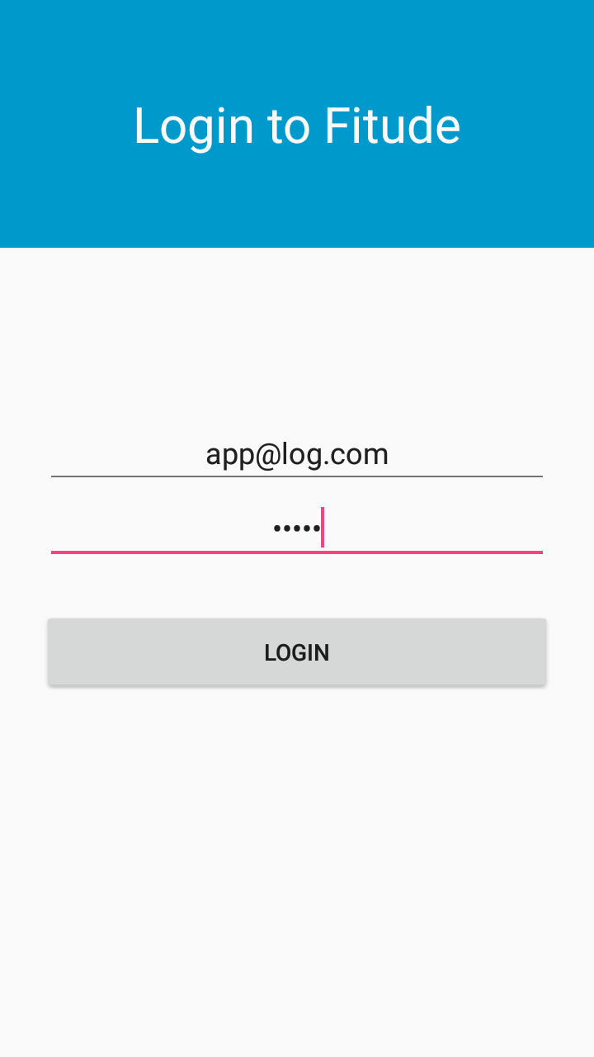
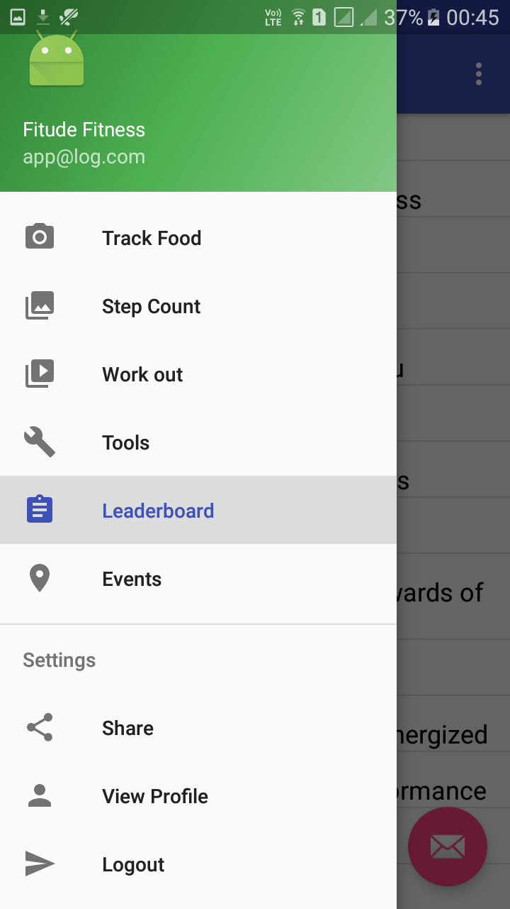
LOGIN PAGE

Slide 5
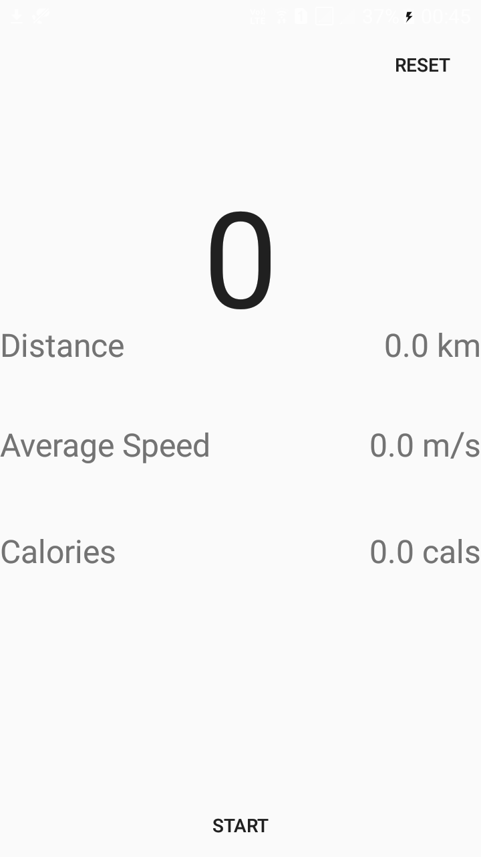
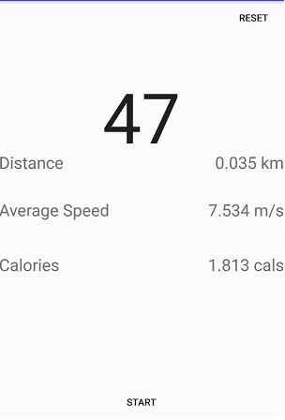
STEP COUNT

Slide 6
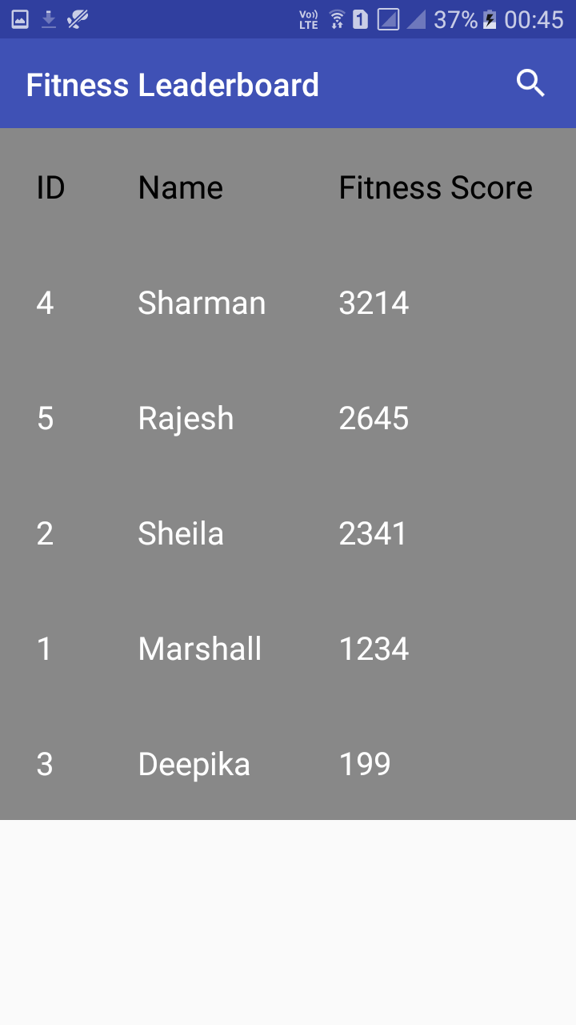
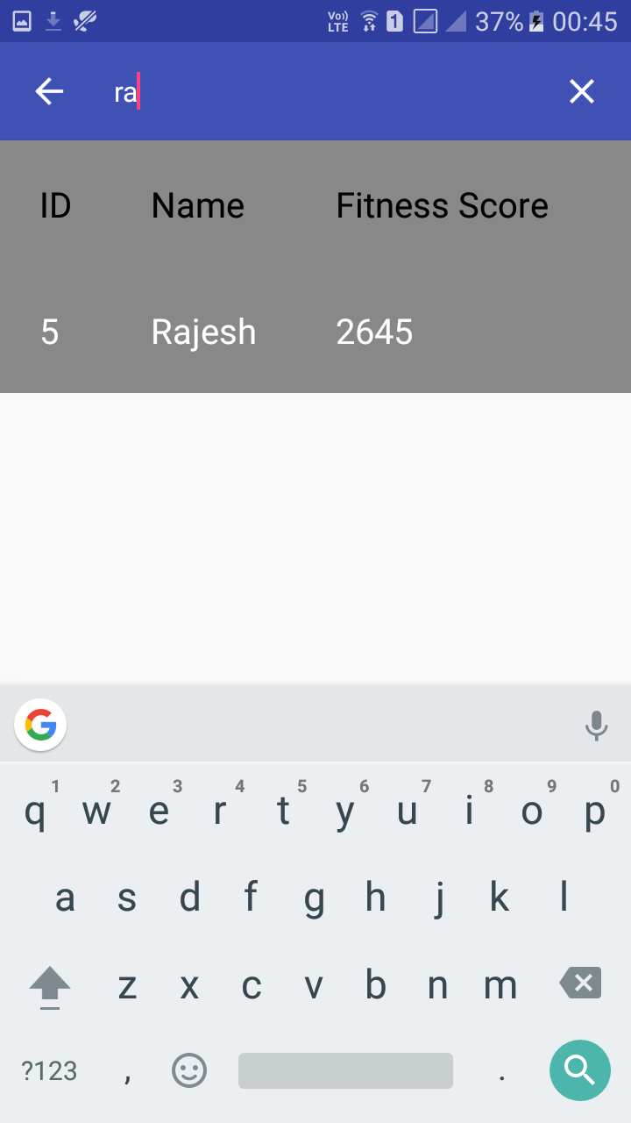
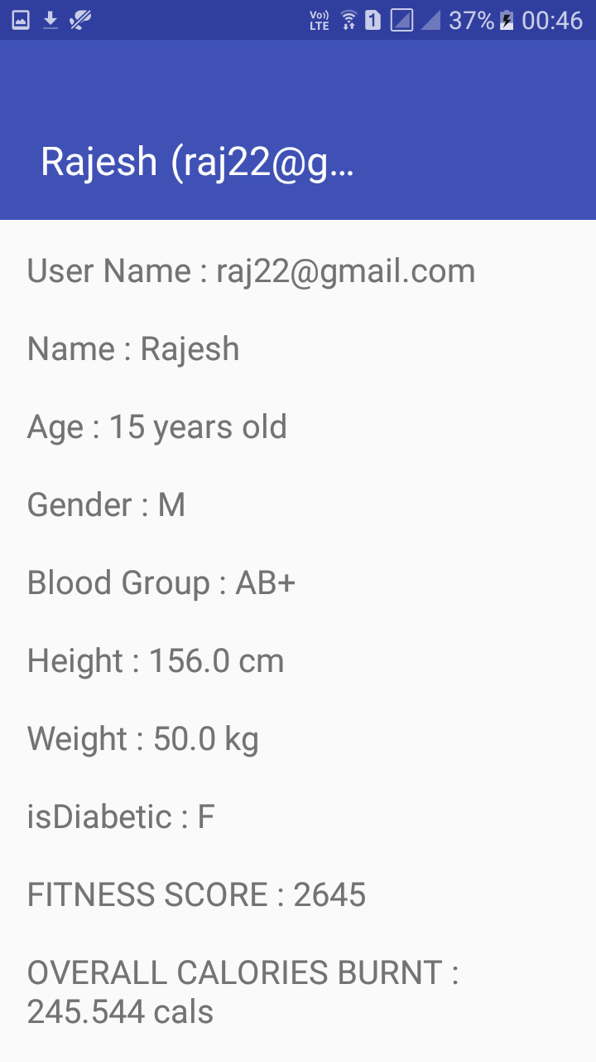
LEADERBOARD

Slide 7
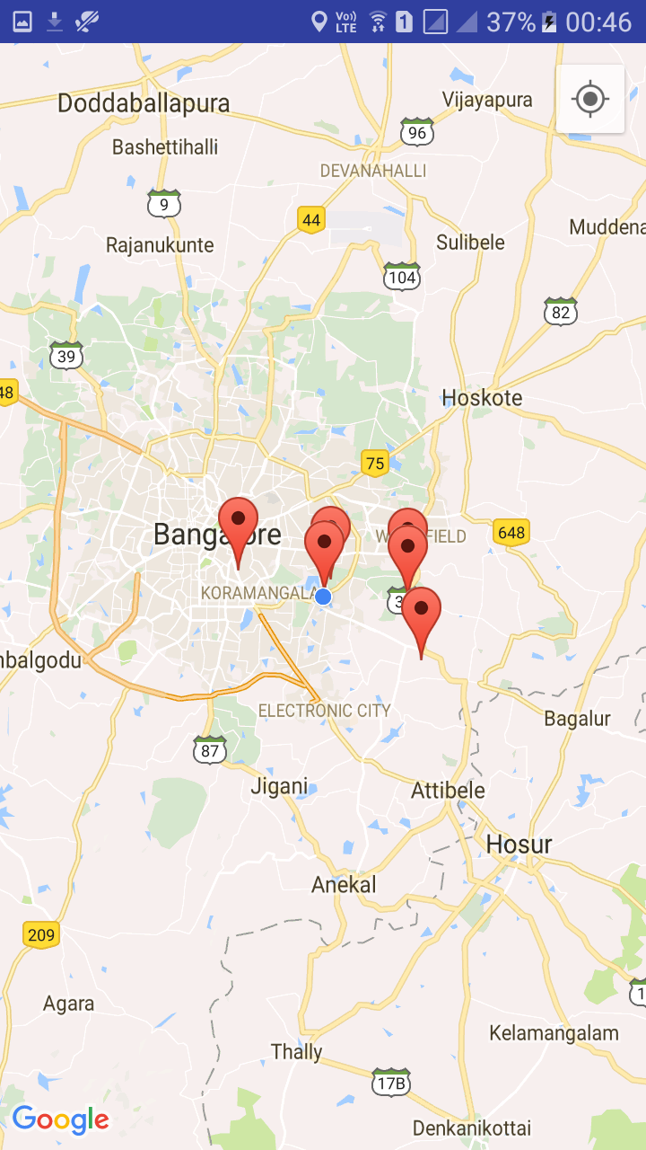
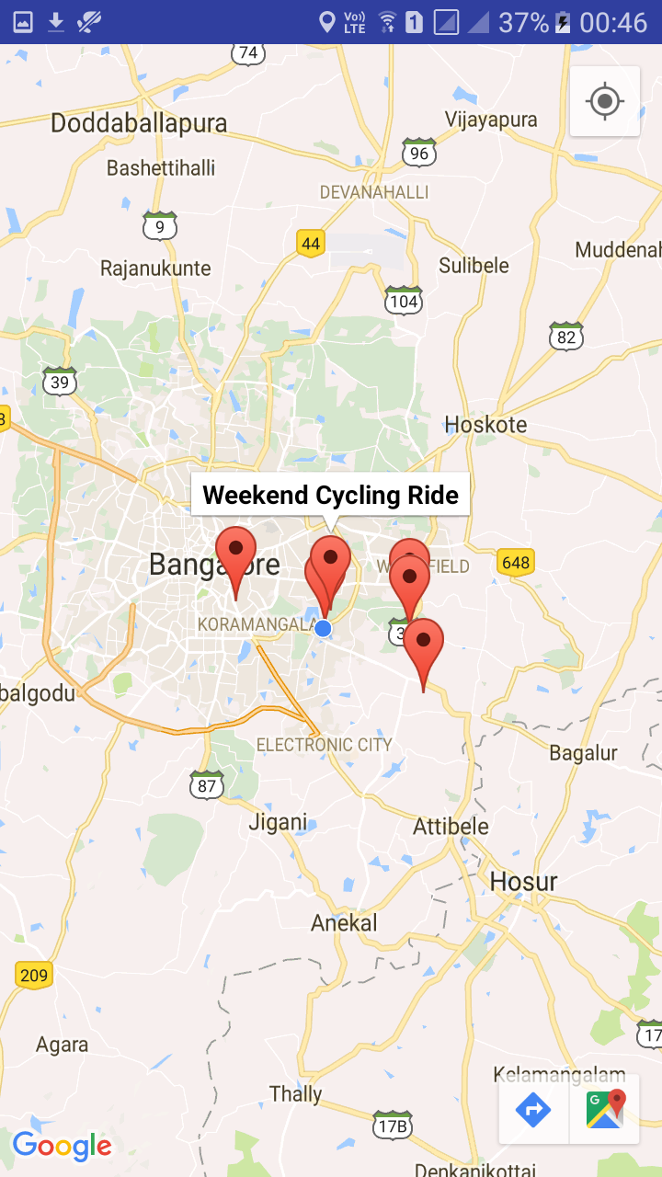
EVENTS

Slide 8
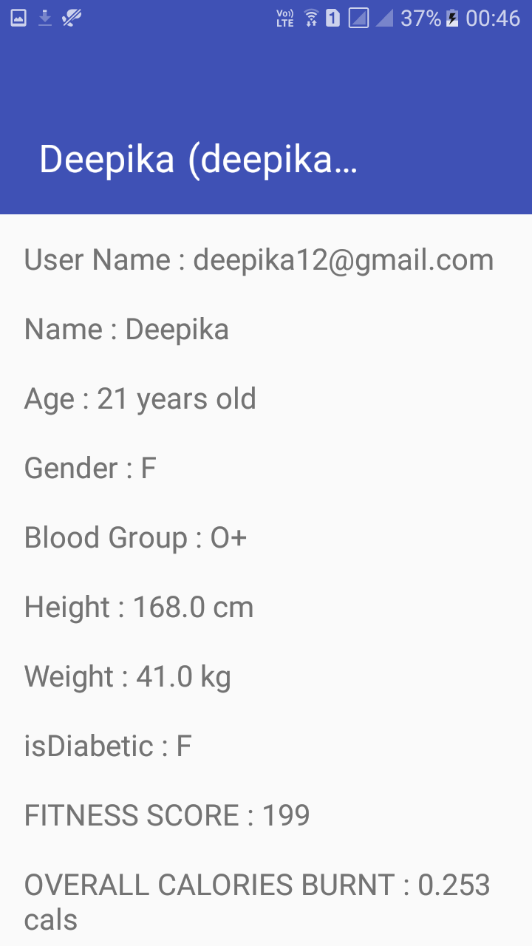
USER PROFILE

Slide 9

WEB APP
Dashboard
yes
Leaderboard
login
User profile
no
logout
Database
Register
Events
Map

Slide 10
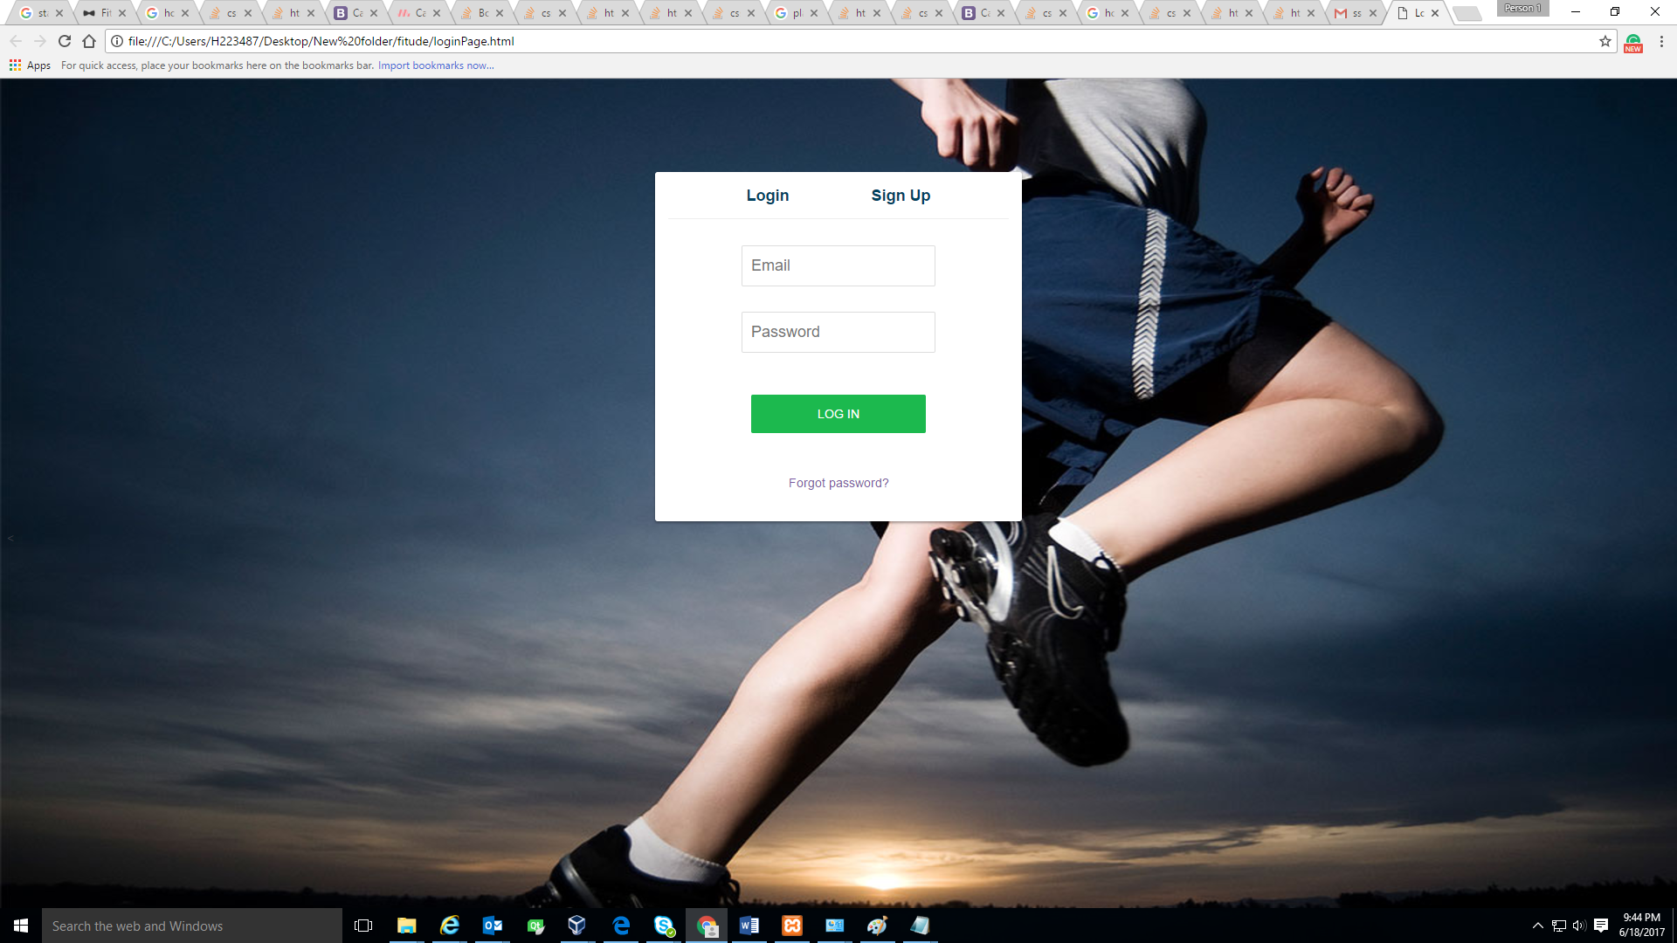
LOGIN

Slide 11
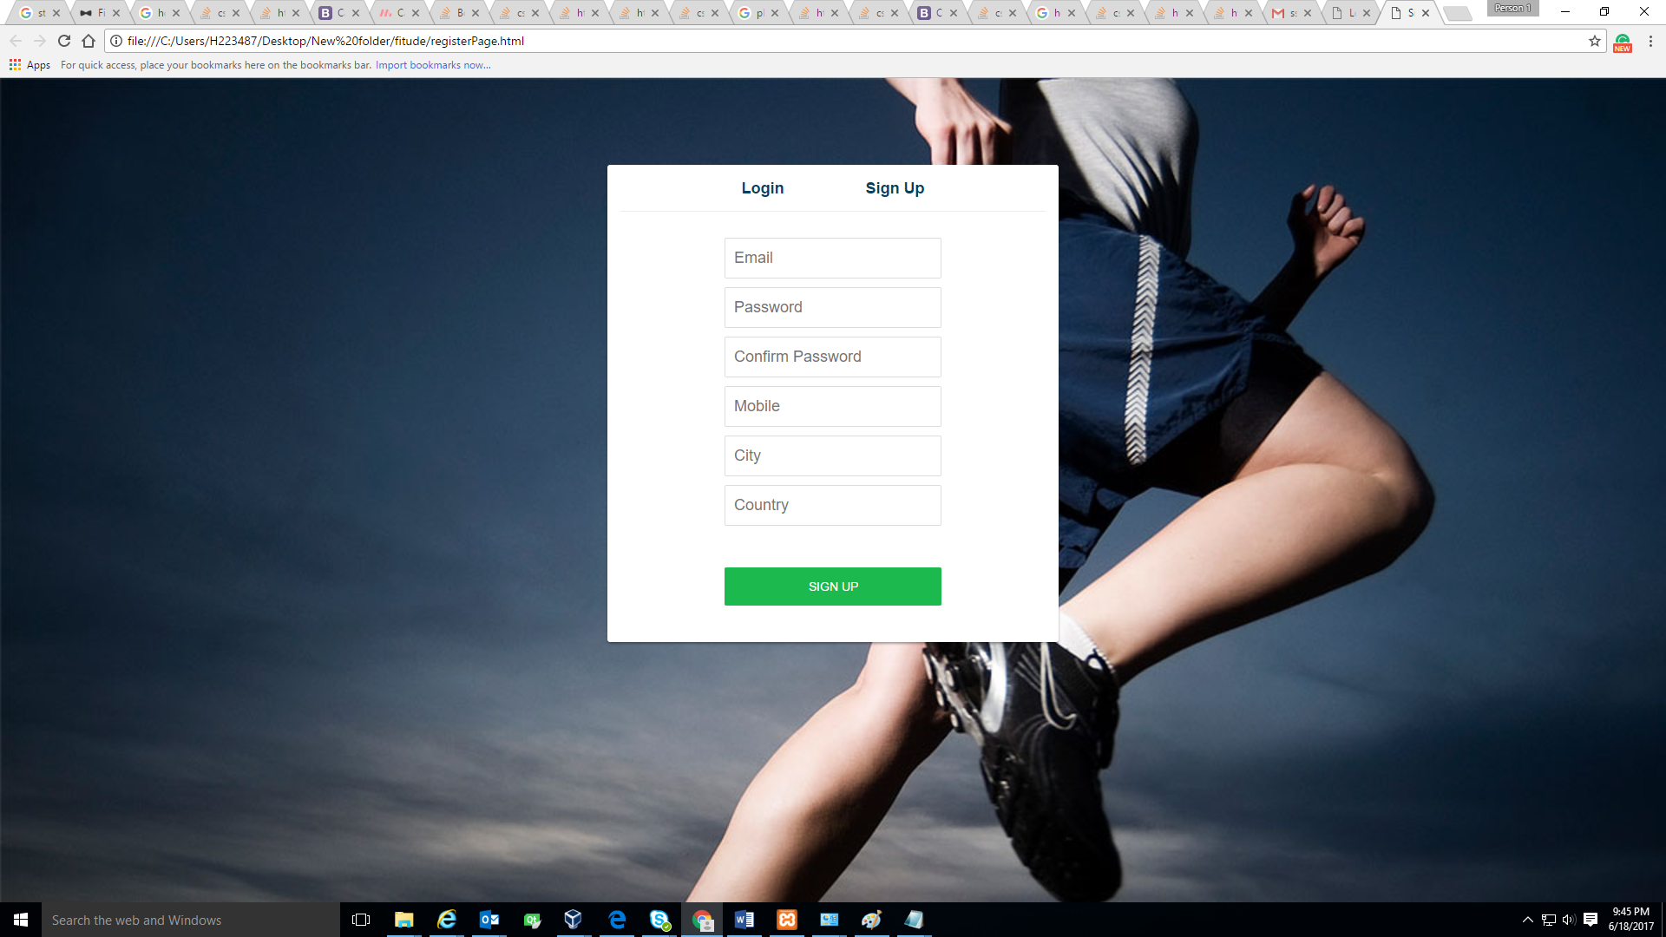
REGISTER

Slide 12
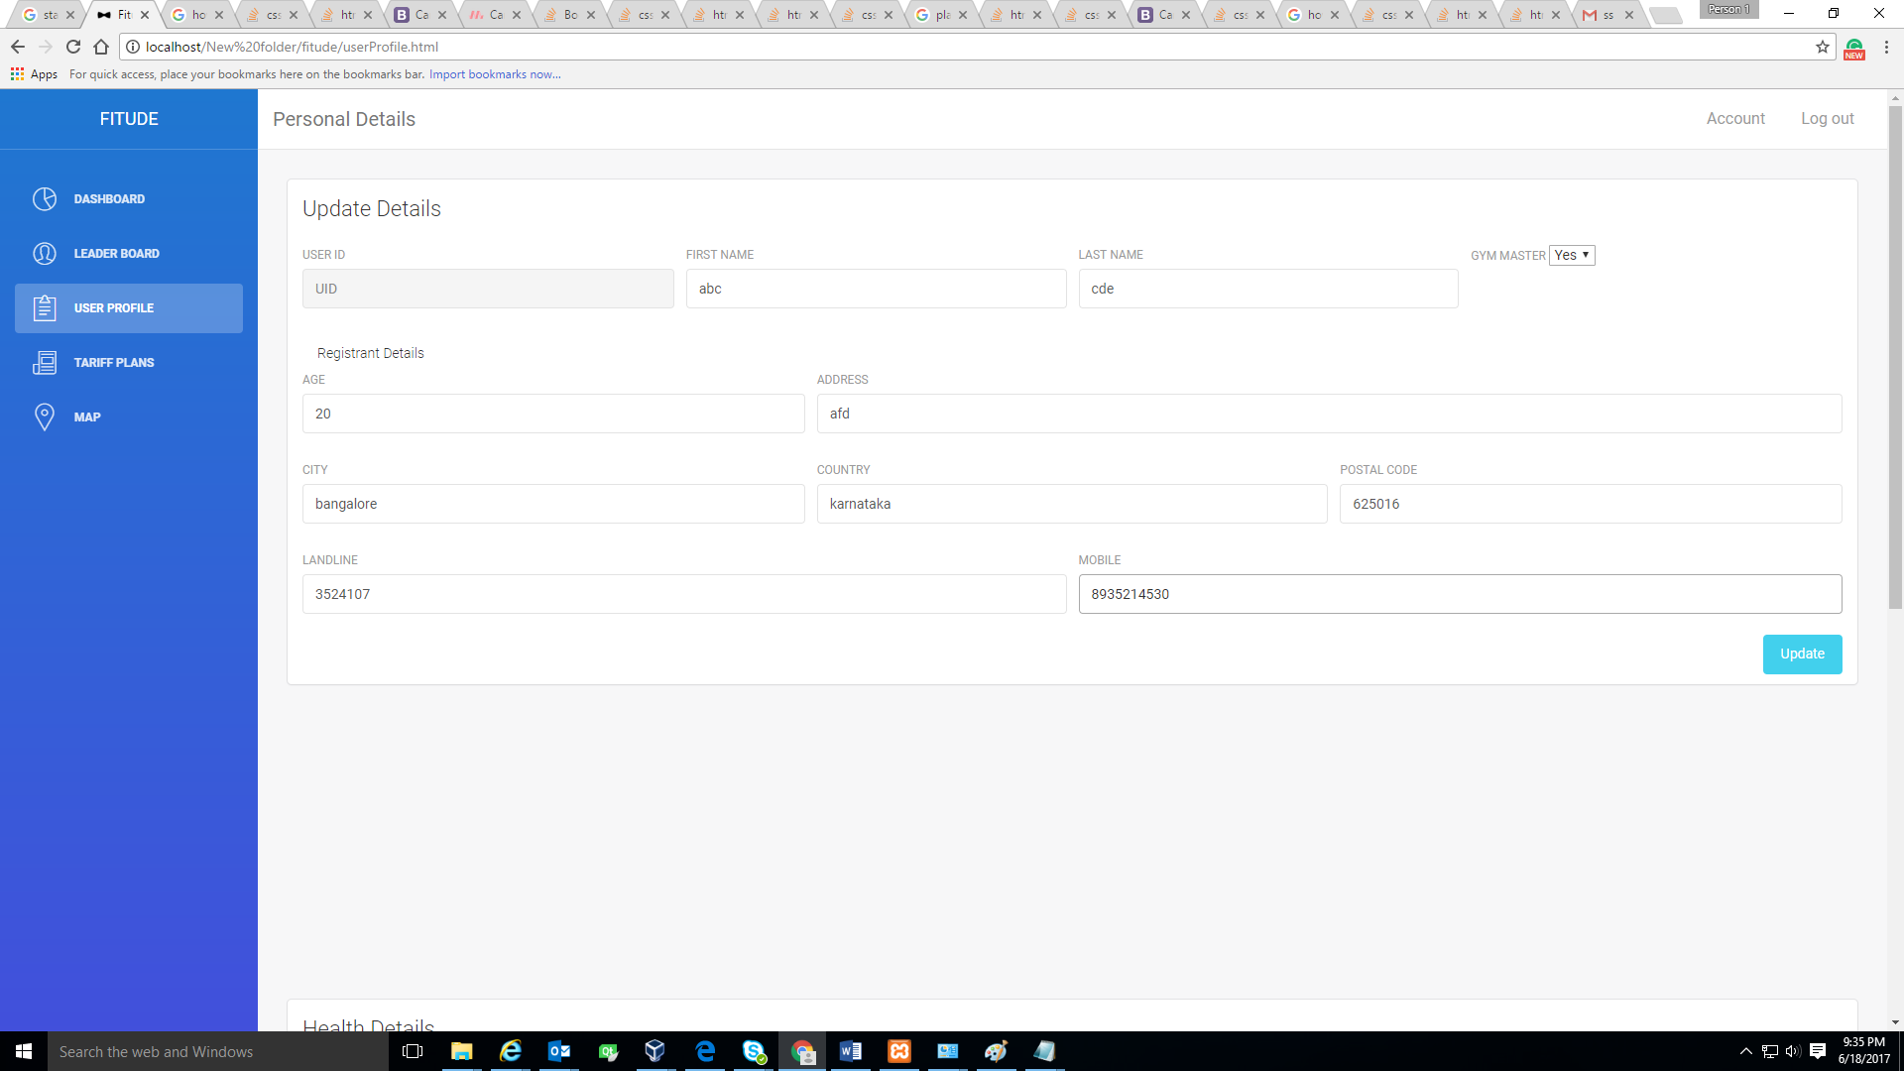
USER PROFILE

Slide 13
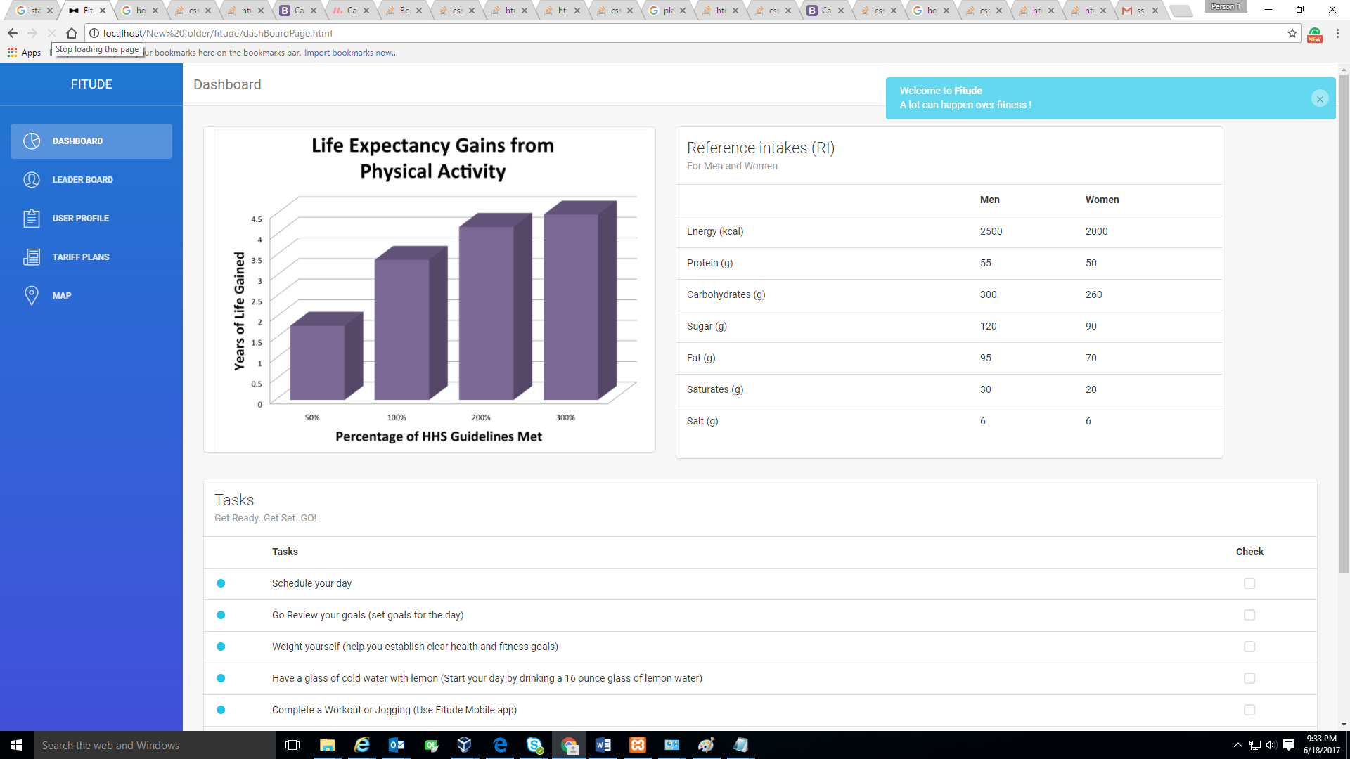
DASHBOARD

Slide 14
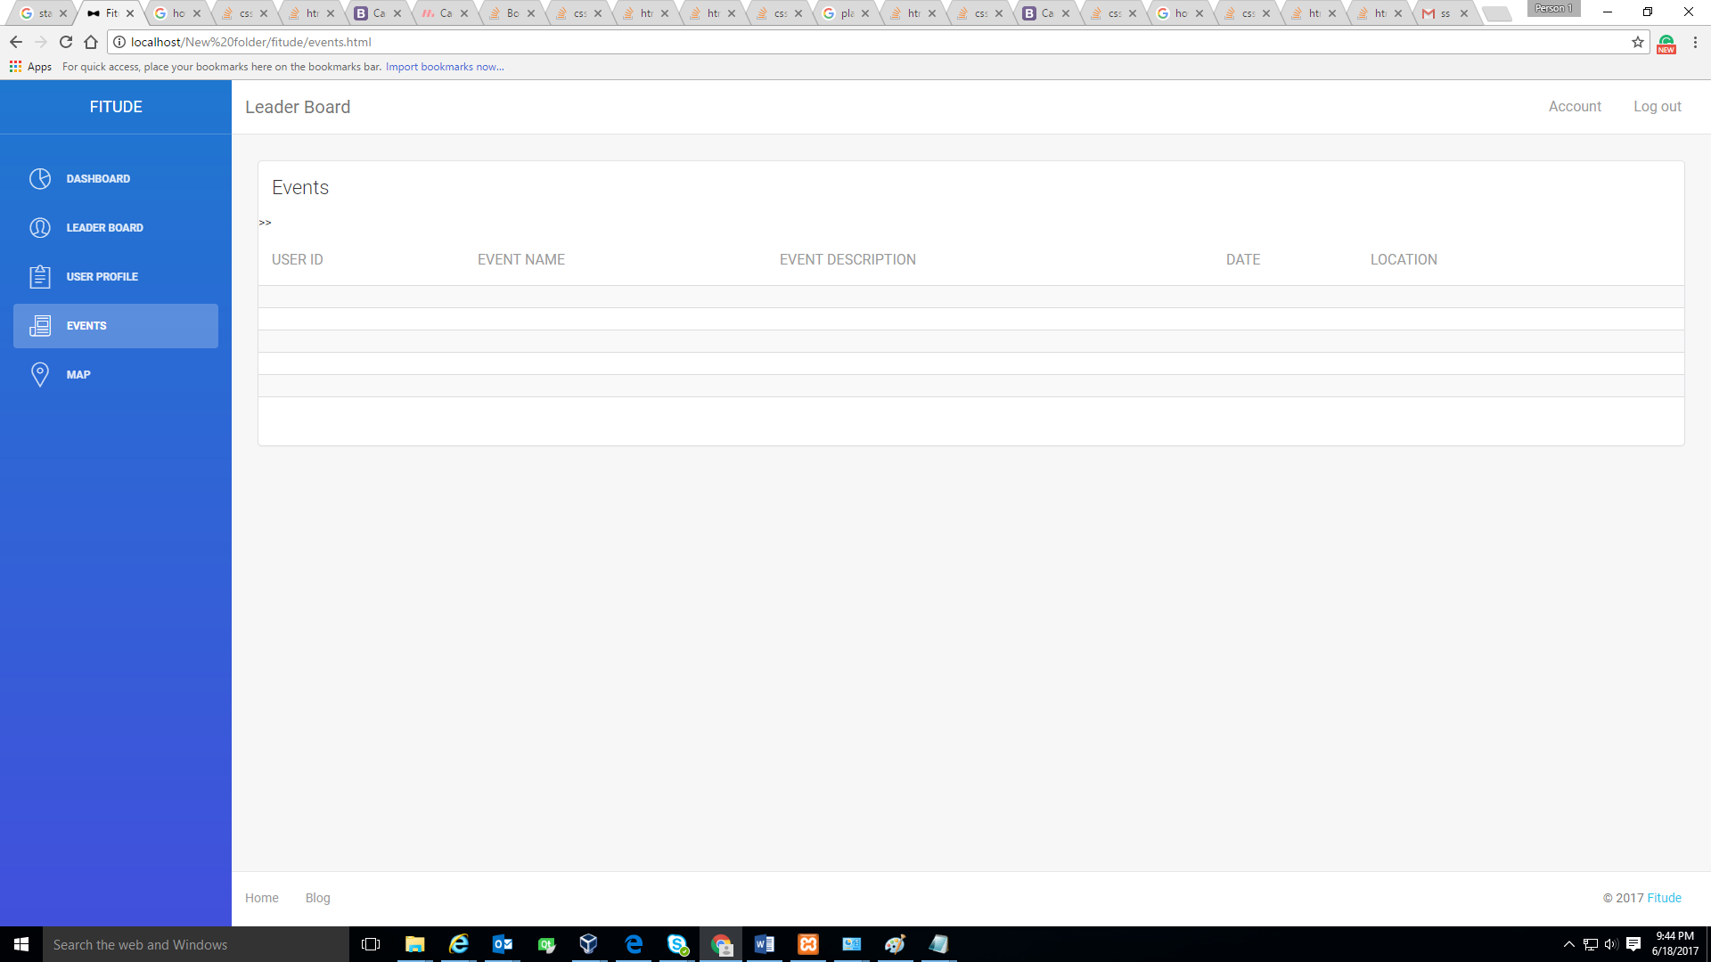
EVENTS

Slide 15
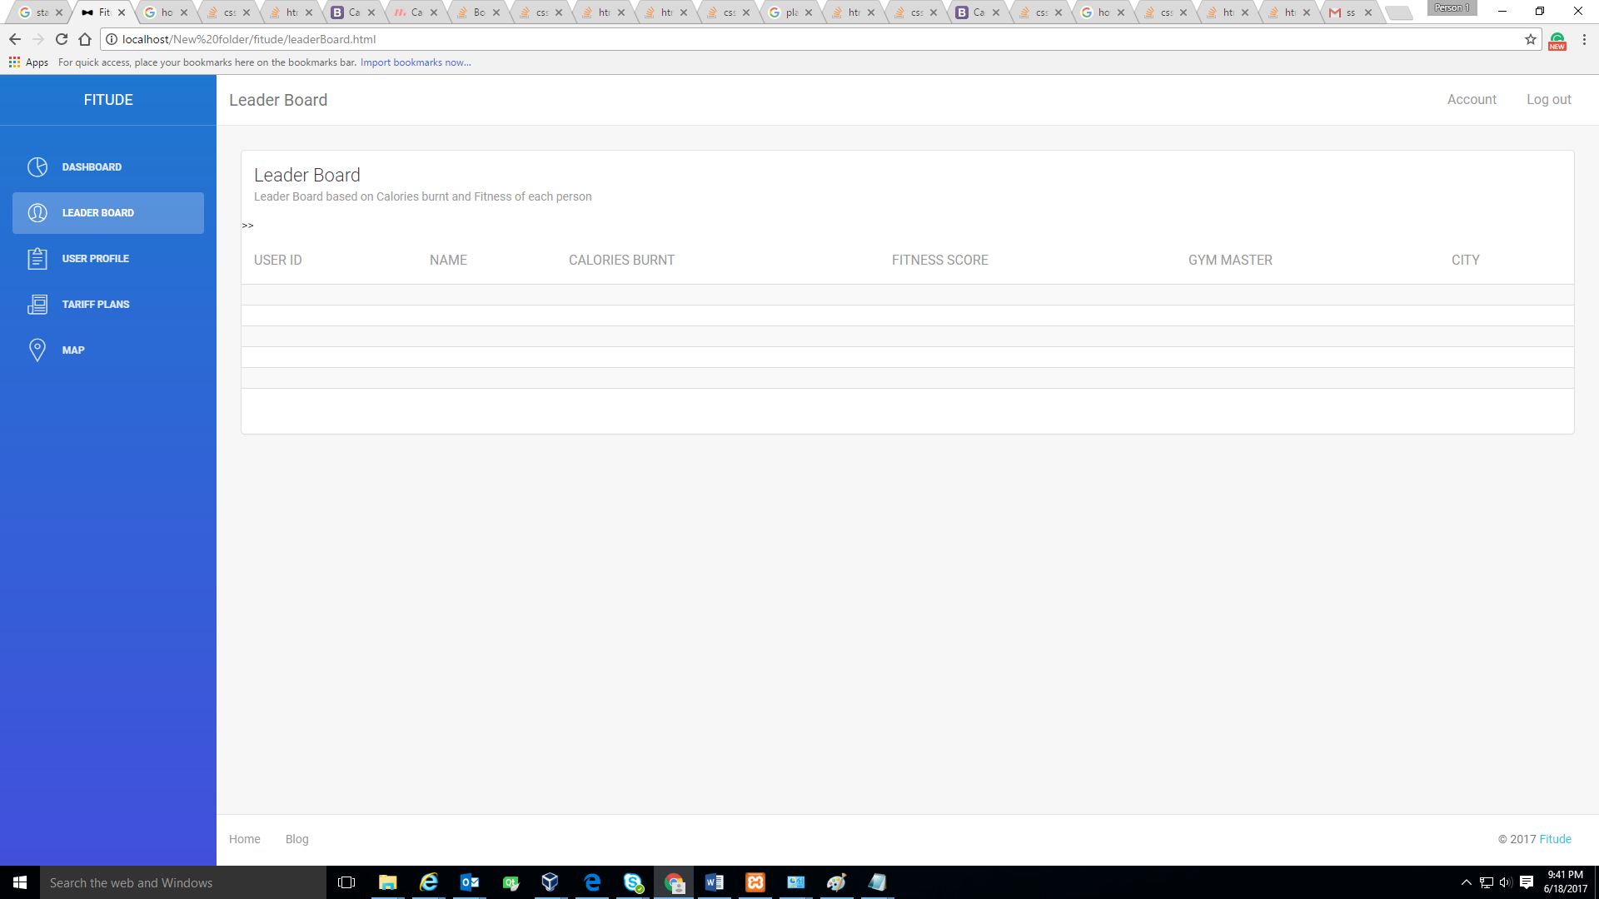
LEADERBOARD

Slide 16
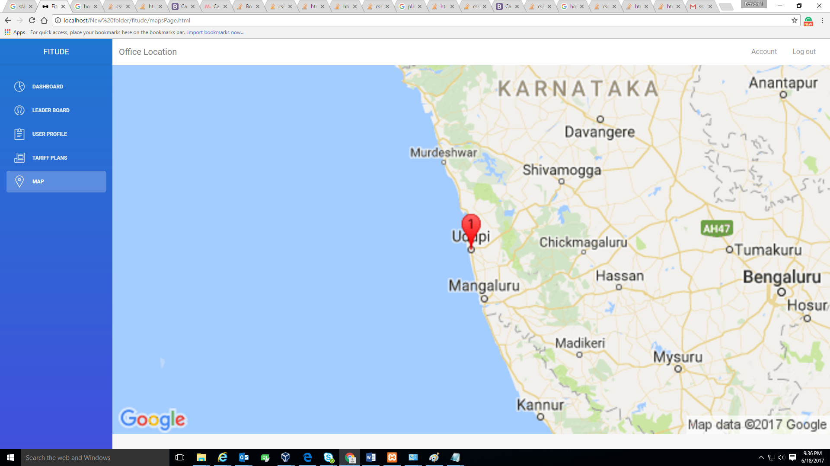
MAP

